Slide 1

Notes:
This presentation covers how to effectively use Claude Code for development. While focused on Claude Code specifically, many concepts transfer to other AI coding agents.

Slide 2
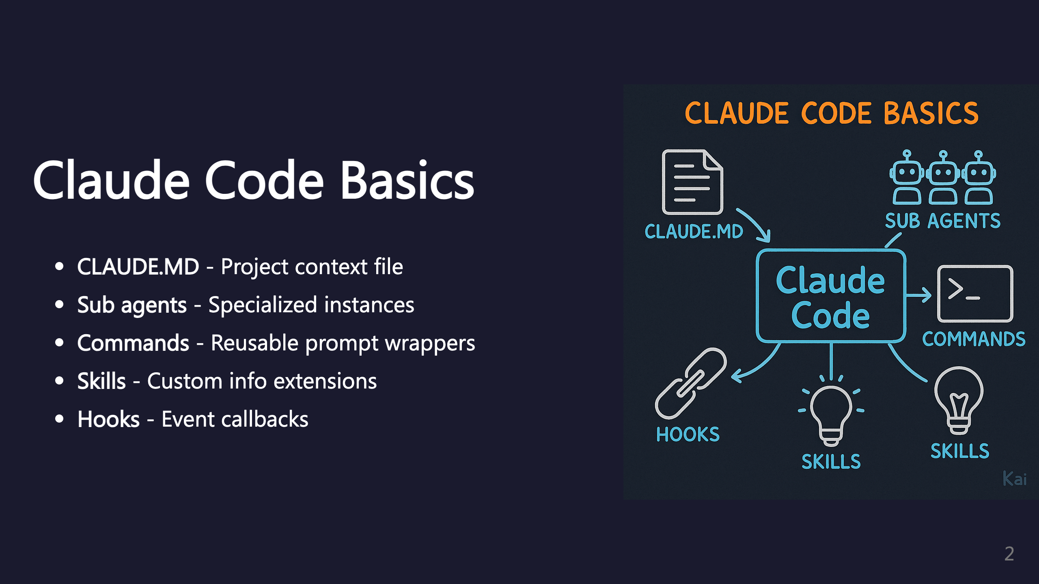
Notes:
These are the five core building blocks of Claude Code. Links: - Sub agents: https://code.claude.com/docs/en/sub-agents - Commands: https://code.claude.com/docs/en/slash-commands - Skills: https://code.claude.com/docs/en/skills - Hooks: https://code.claude.com/docs/en/hooks-guide

Slide 3
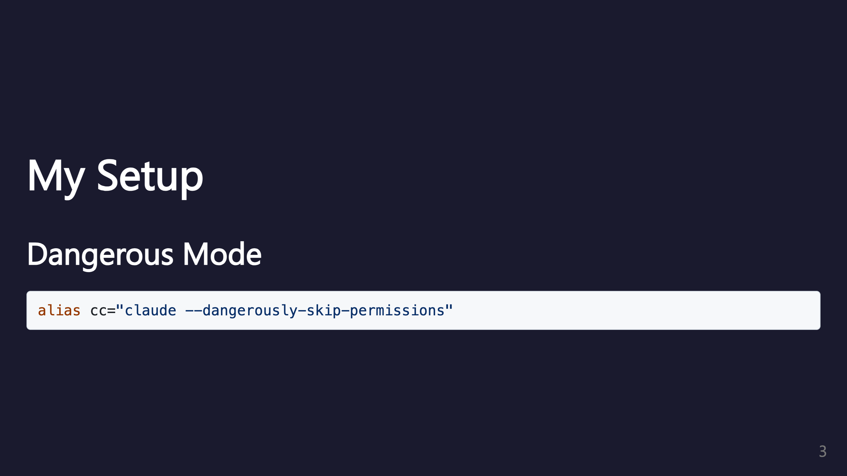
Notes:
This alias skips permission prompts for faster iteration. Use with caution - only in trusted environments.

Slide 4
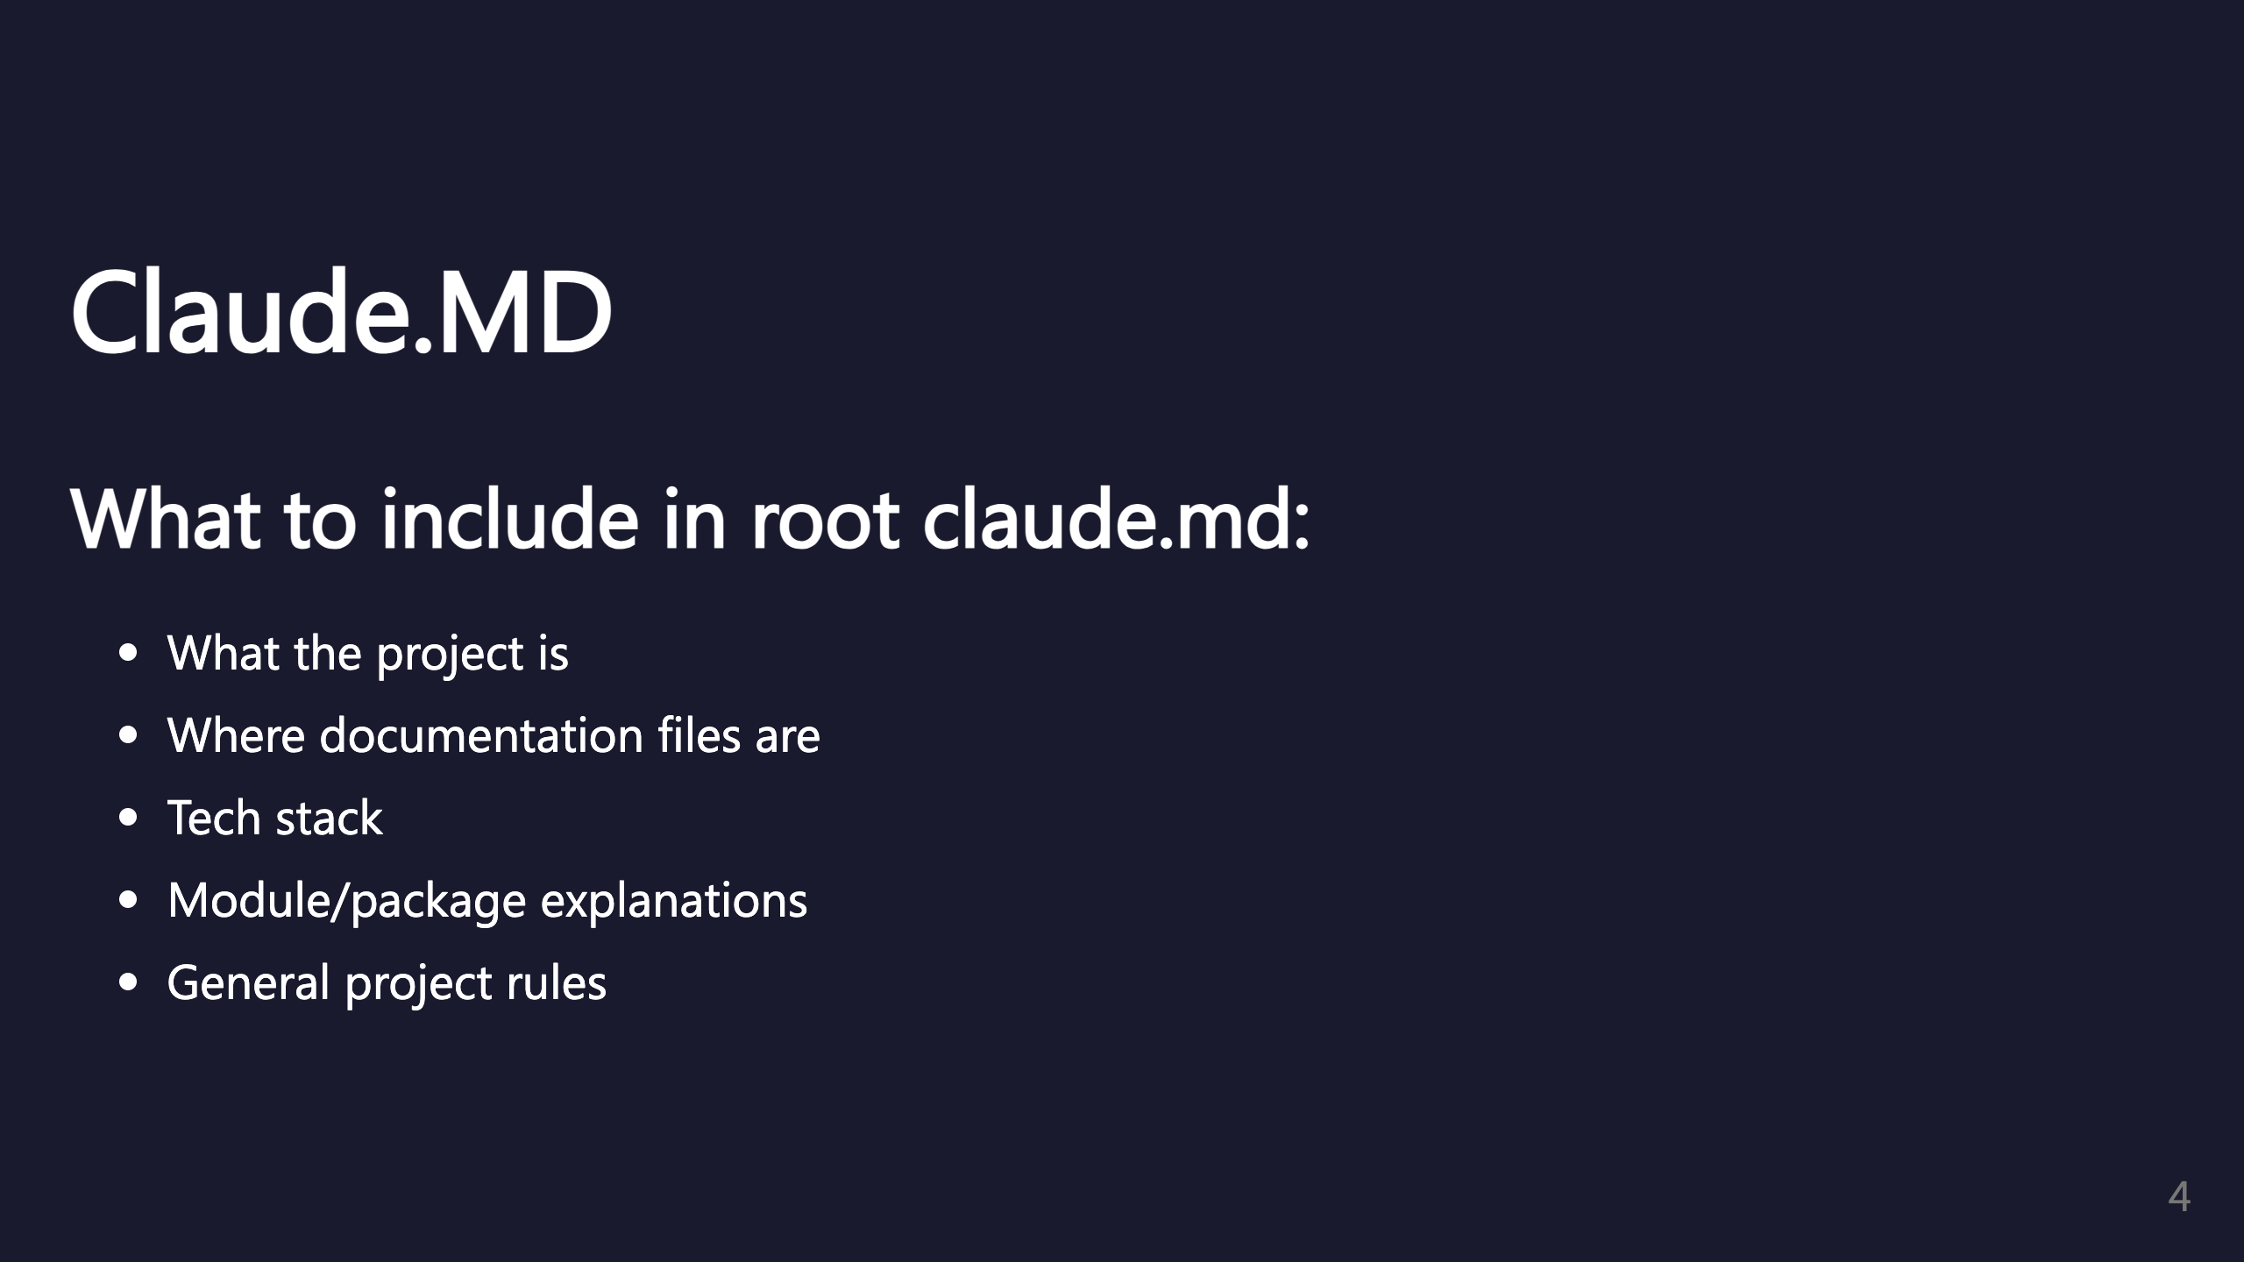
Notes:
Always have a root CLAUDE.MD file. This is the primary way to give Claude context about your project.

Slide 5
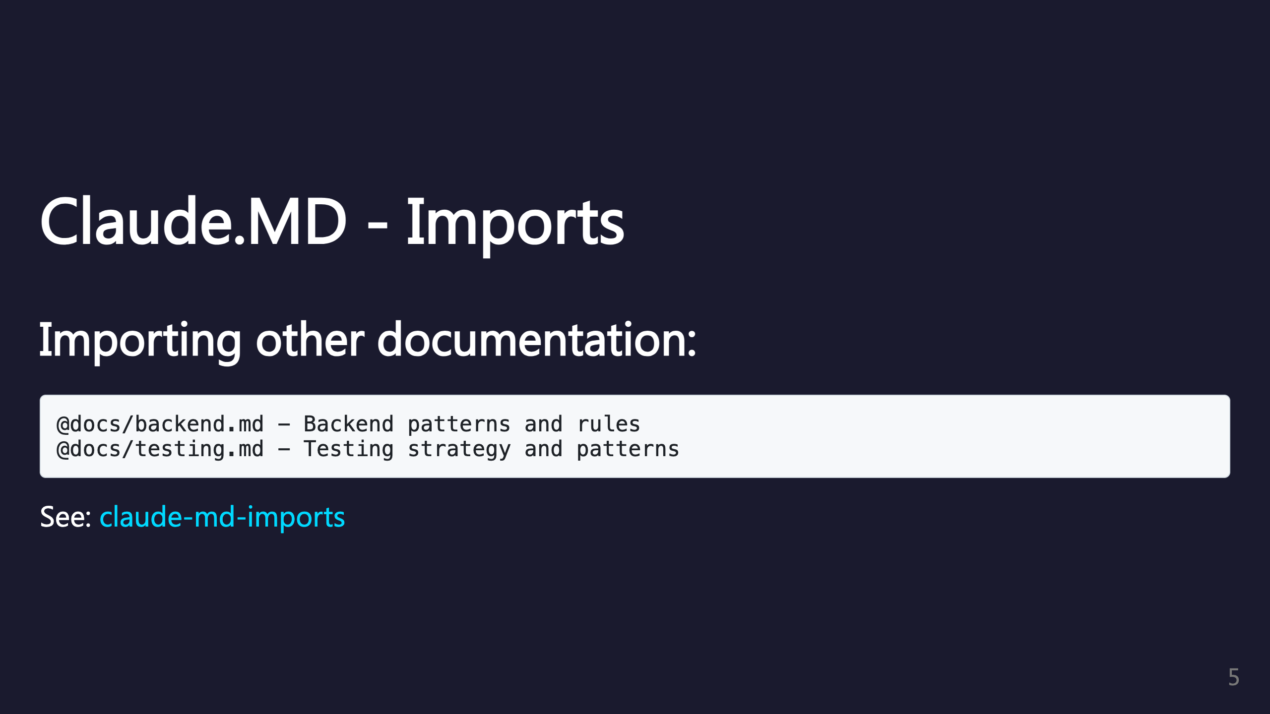
Notes:
You can import other markdown files to keep documentation modular. This helps organize large projects.

Slide 6
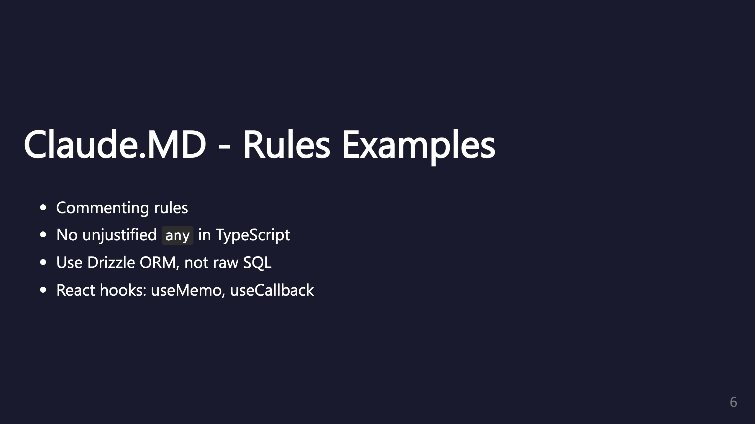
Notes:
Be specific about coding standards. These rules help Claude generate consistent code.

Slide 7

Notes:
Subfolder CLAUDE.MD files provide context specific to that module. Let Claude help maintain its own documentation.

Slide 8
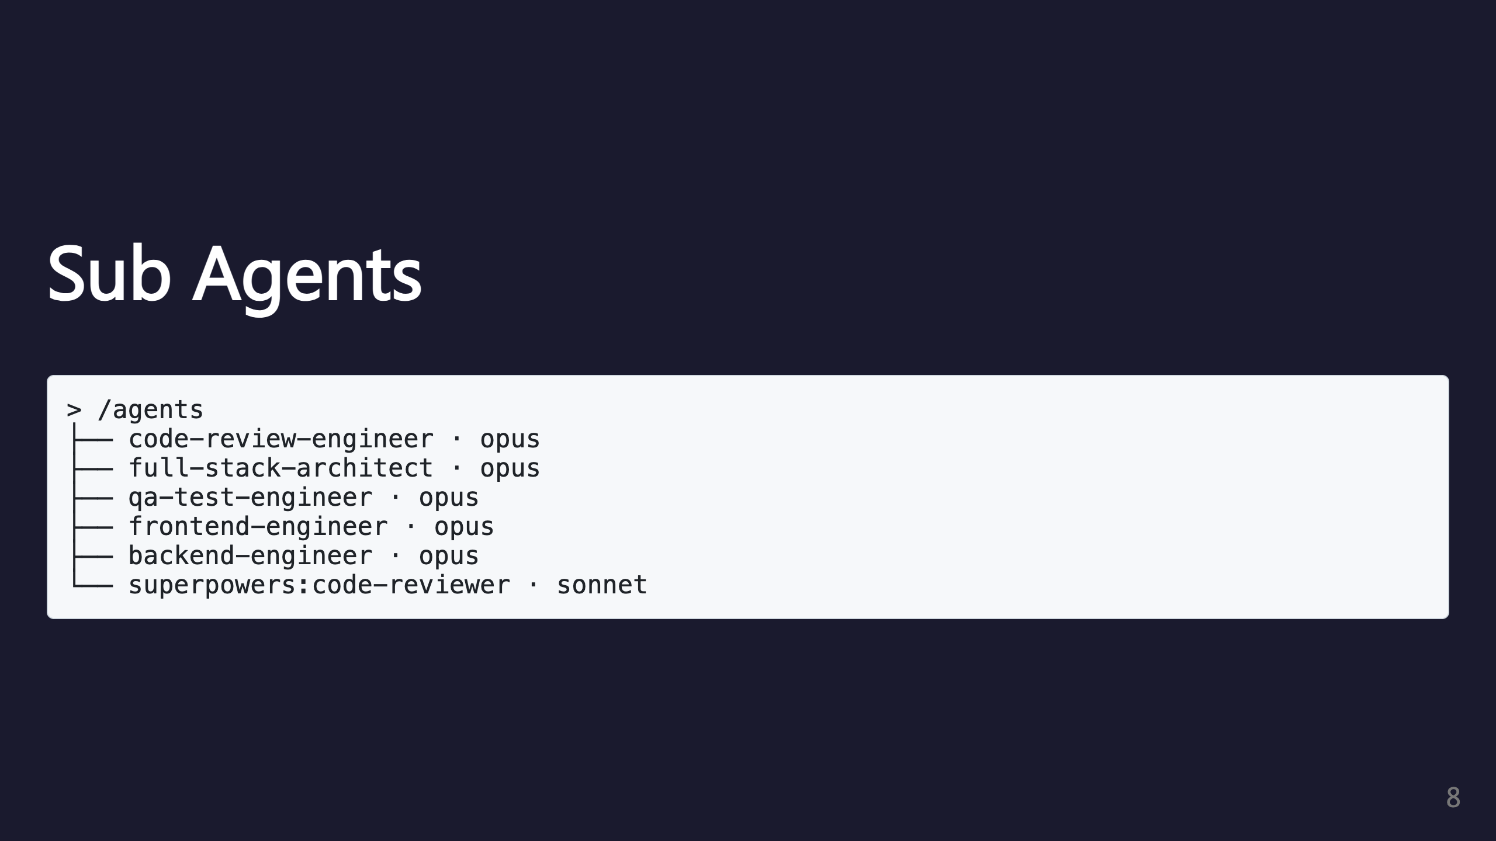
Notes:
This shows the /agents command output. Agents can be at project level or global level.

Slide 9

Notes:
The context benefit is huge - complex tasks don't exhaust your main conversation. Explicit handover rules are good to define. Claude uses agents automatically but explicit prompting helps.

Slide 10
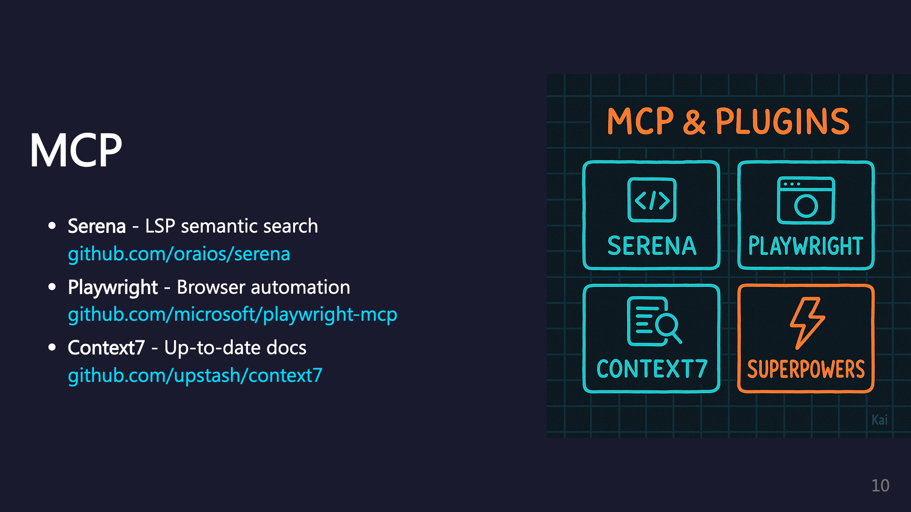
Notes:
MCP = Model Context Protocol servers. These extend Claude's capabilities with specialized tools.

Slide 11
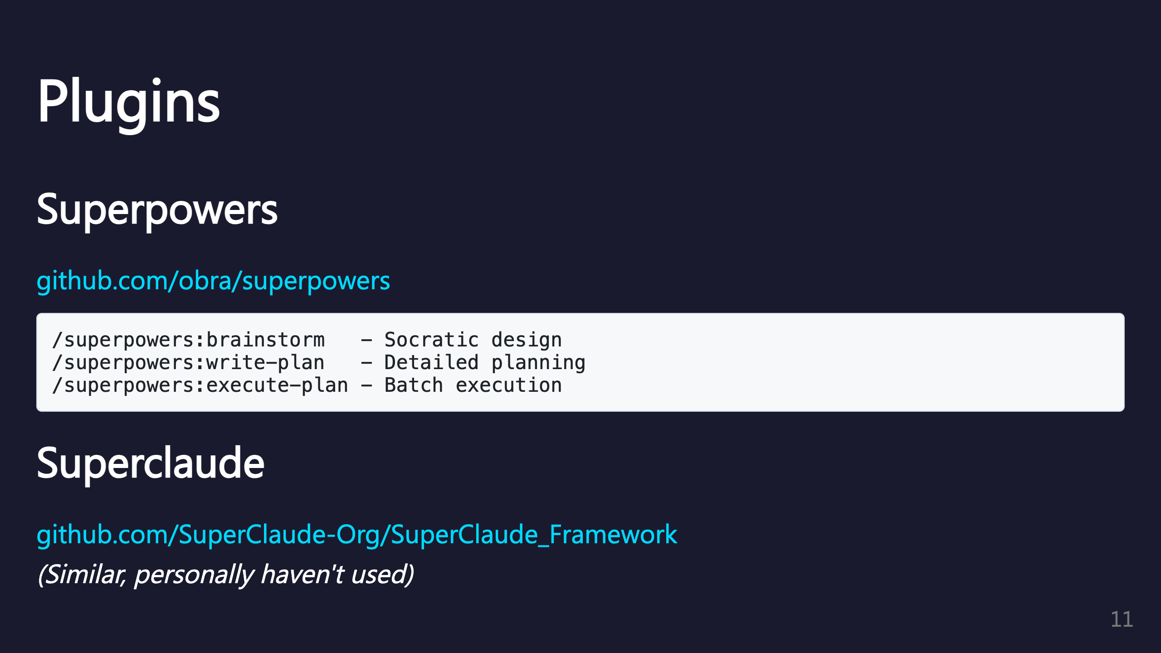
Notes:
Superpowers provides structured workflows for brainstorming, planning, and execution.

Slide 12
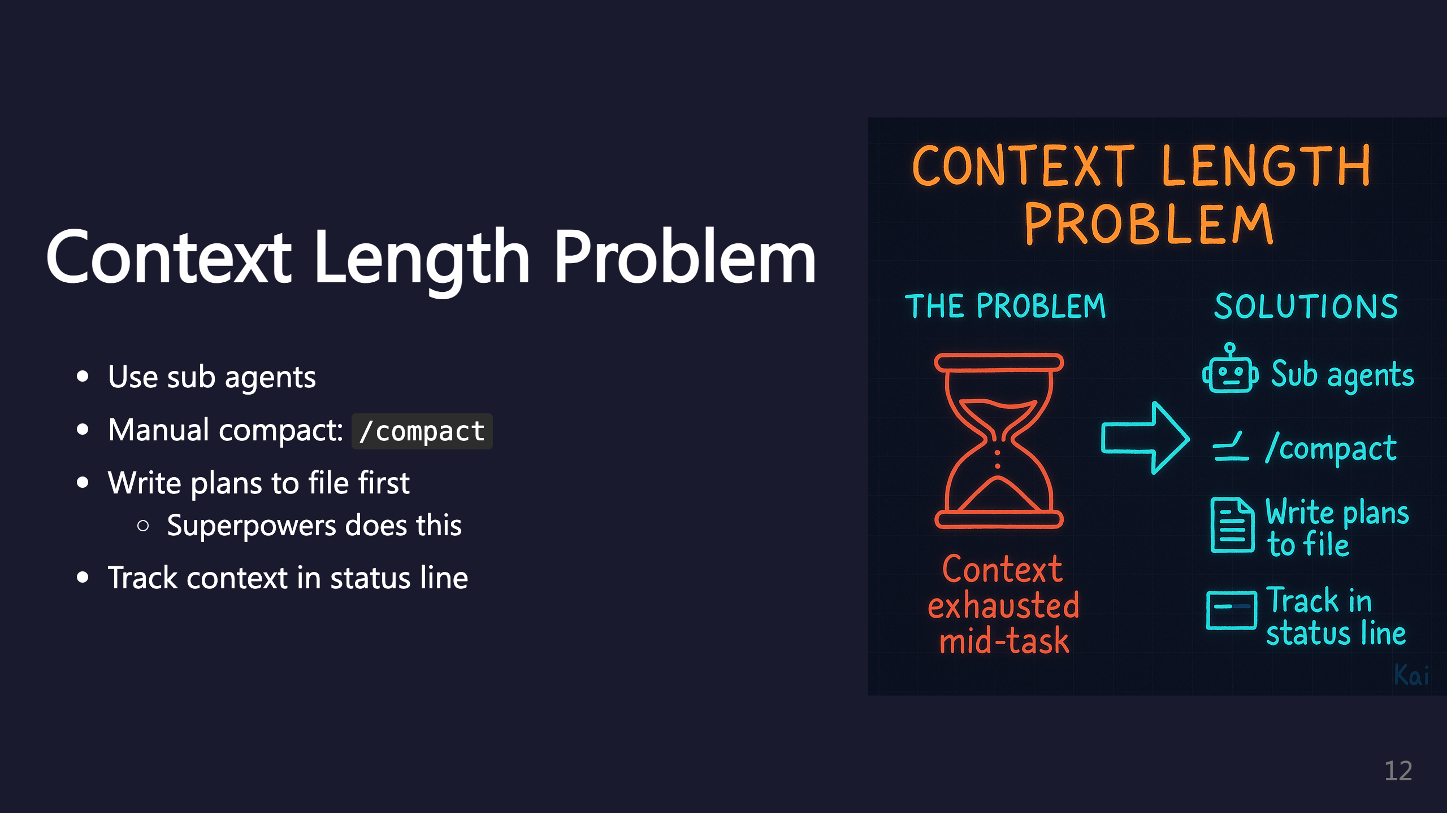
Notes:
Context exhaustion is the #1 challenge with AI coding. The status line tool: https://github.com/sirmalloc/ccstatusline Example: cwd: ~/project | Model: Opus 4.5 | Ctx: 126.4k | Ctx(u): 79.0%

Slide 13

Notes:
TODO section from source file.

Slide 14

Notes:
TODO section from source file.

Slide 15

Notes:
TODO section from source file.

Slide 16

Notes:
TODO section from source file.

Slide 17
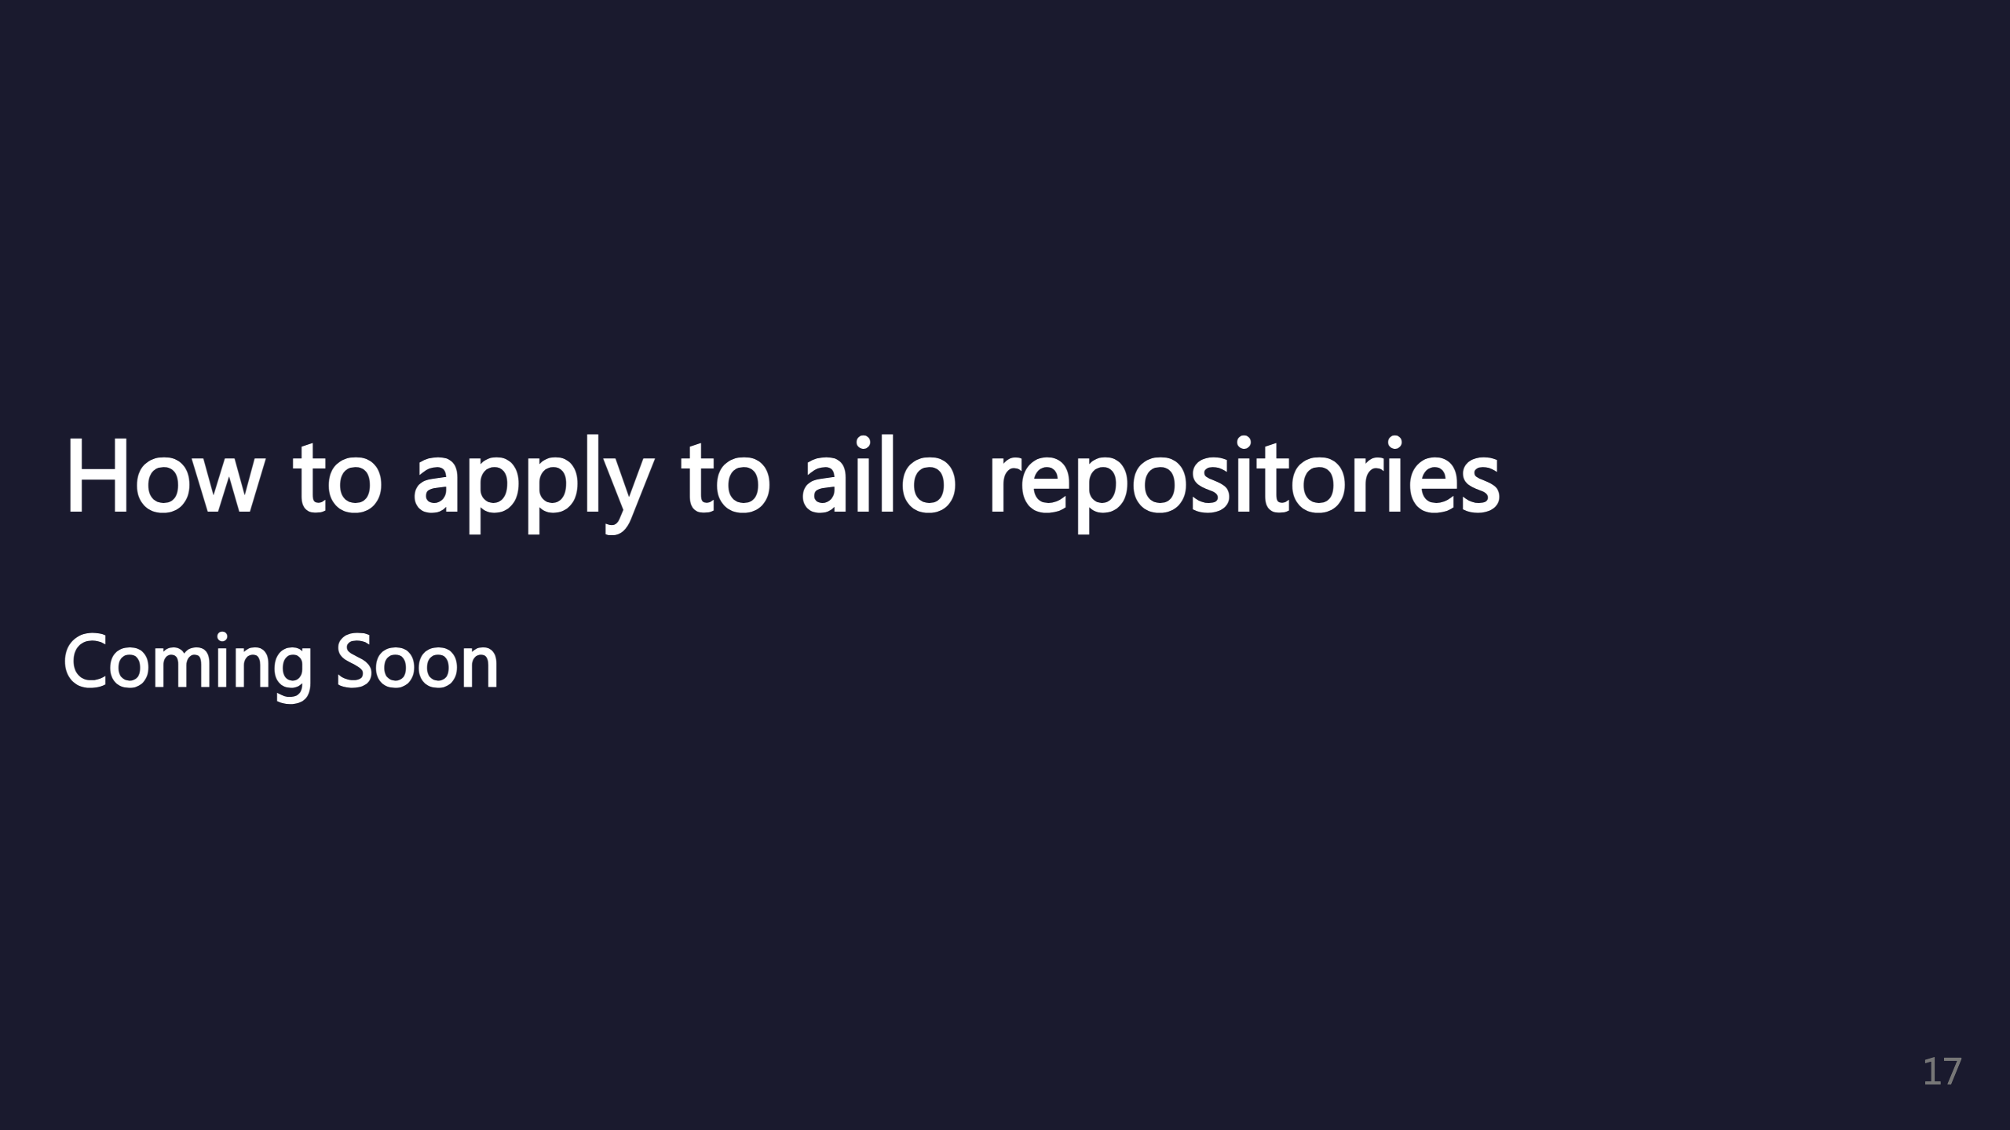
Notes:
TODO section from source file.

